Slide 1
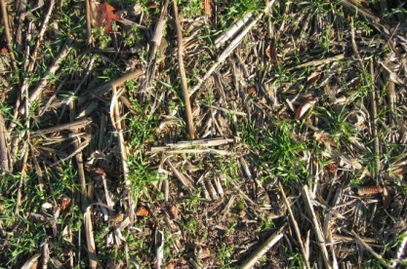
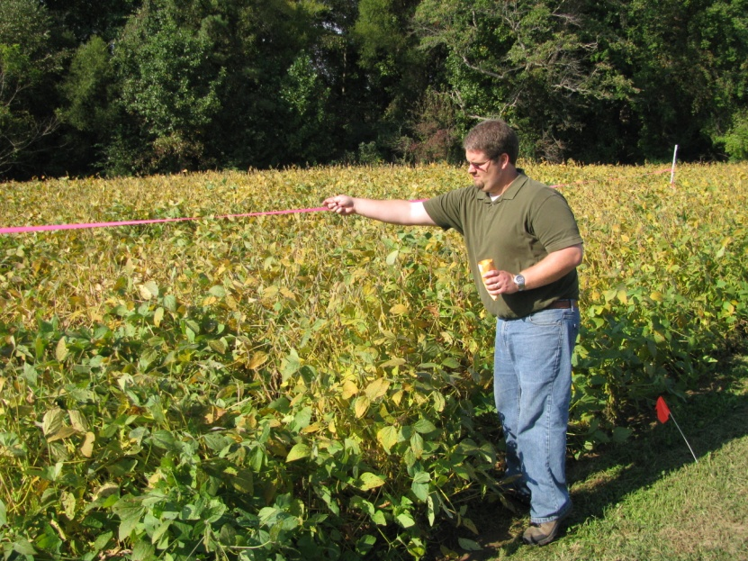
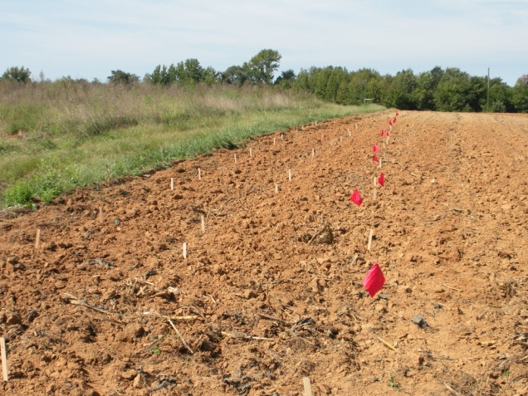
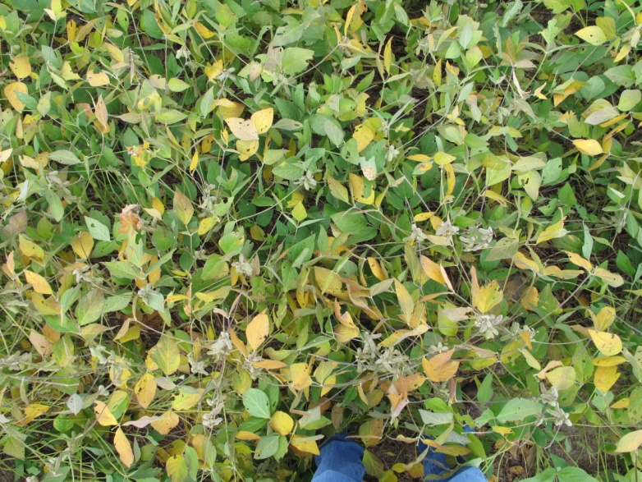
2009 Plots
Cover Crop | Rate
Rye (assumes 56 lb/bu) | 3 bu/ac
Barley (assumes 48 lb/bu) | 3 bu/ac
Crimson Clover | 20 lb/ac
Vetch | 20 lb/ac
Rye+Crimson Clover | 2 bu + 10 lb/ac
Rye+Vetch | 2 bu + 10 lb/ac
Site | Seeding Date | Previous Crop | Conditions
Halifax | 21-Oct | Corn | Tilled
Middlesex | 1-Oct | Soybean | Before leaf drop
Greensville | 28-Oct | Soybean | After leaf drop
Prince George | 14-Oct | Soybean | 30% leaf drop
Essex | 2-Oct | Corn, 160 bu/ac | Stalks bushogged
Northumberland | 6-Oct | Soybean | Before leaf drop

Slide 2
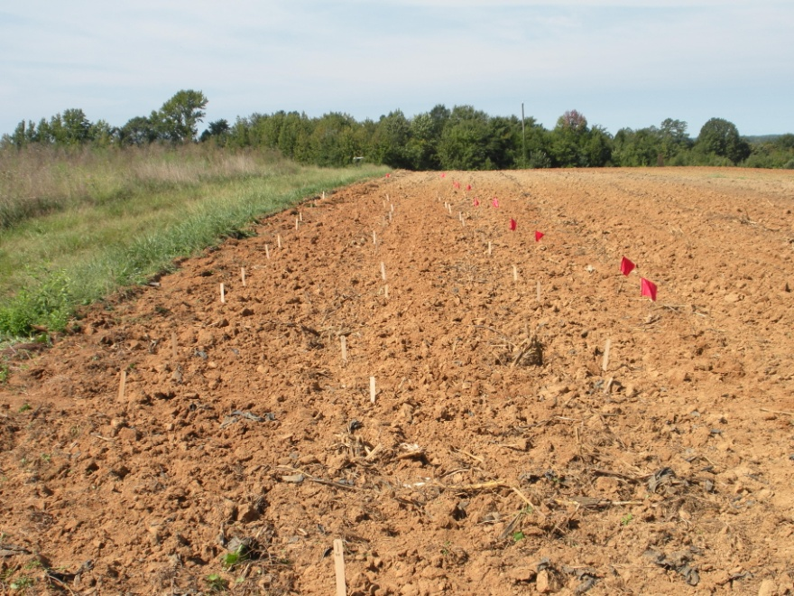
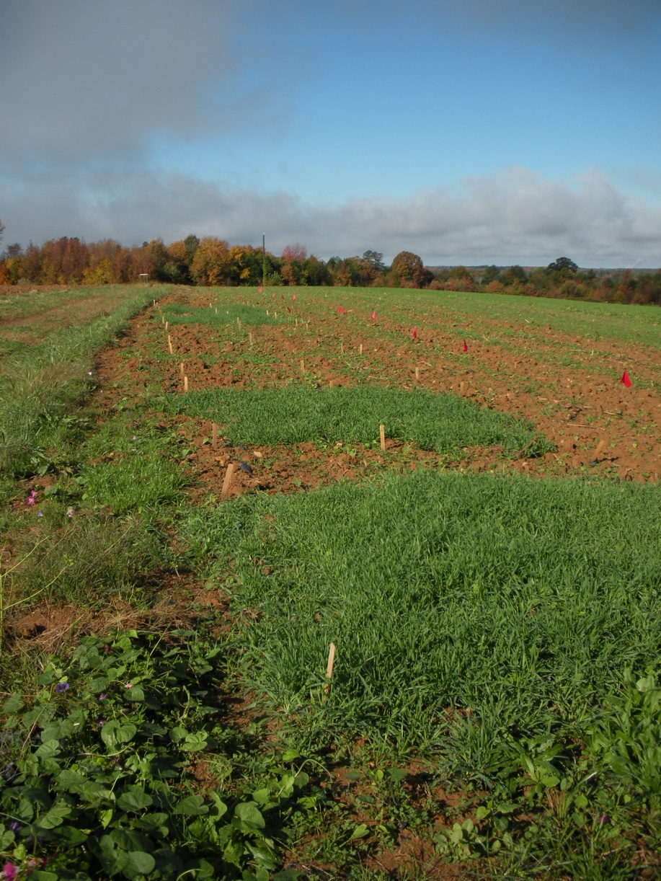
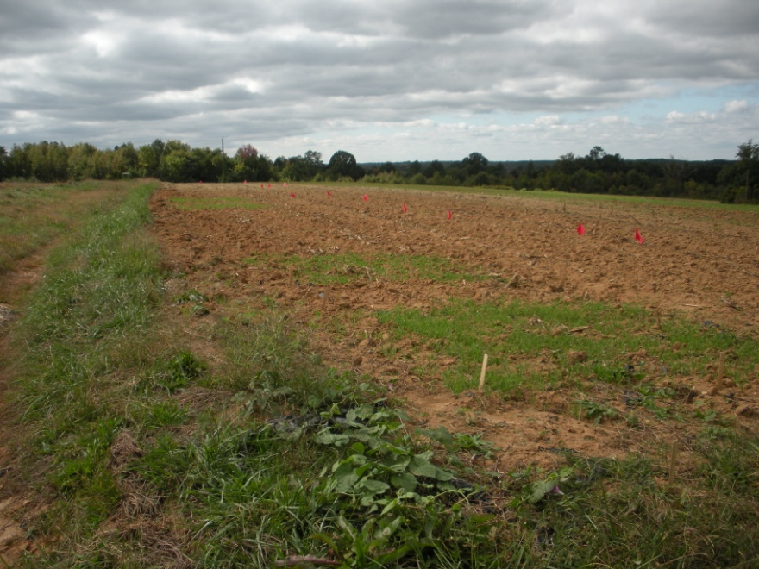
Halifax
Seeding Date | Previous Crop | Conditions
21-Oct | Corn | Tilled
10/21
11/18
10/27

Slide 3


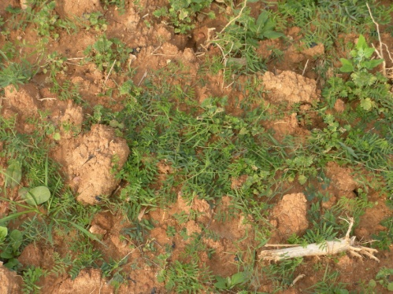

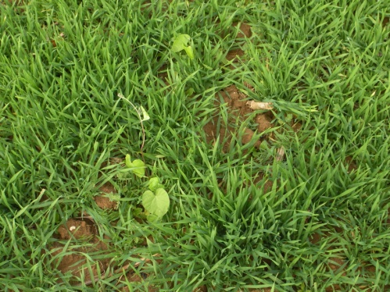

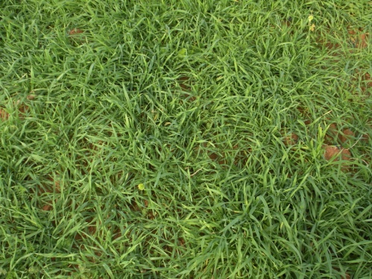

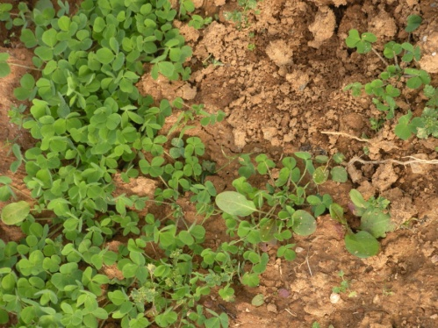

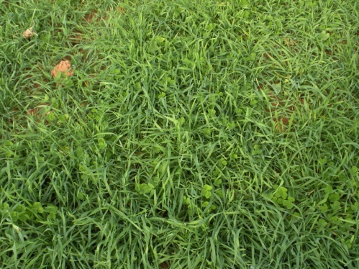

Halifax, 11/18
Seeding Date | Previous Crop | Conditions
21-Oct | Corn | Tilled
Rye, 97.5%
Vetch, 36%
Barley, 90%
Rye+Vetch, 94%
Crimson Clover, 44.6%
Rye+Clover, 97%

Slide 4
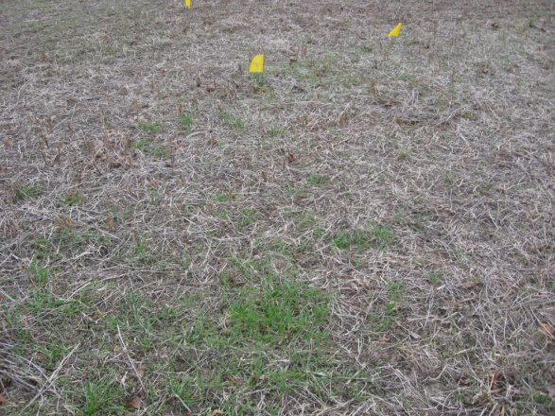
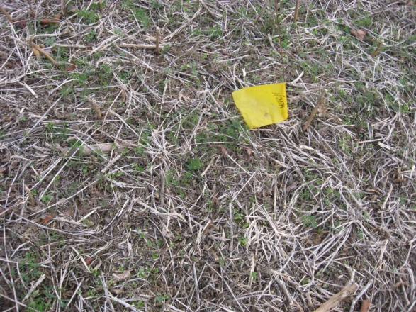
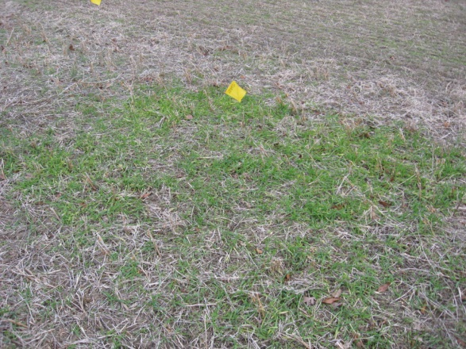
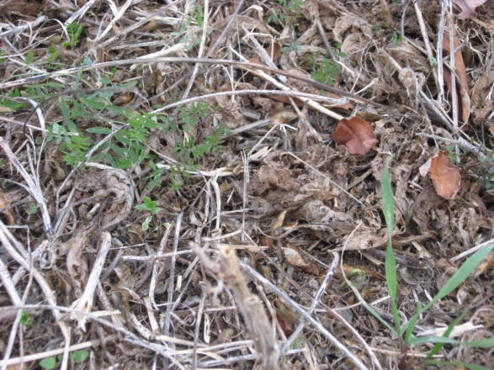
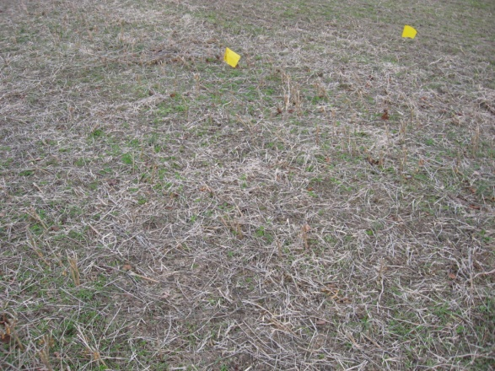
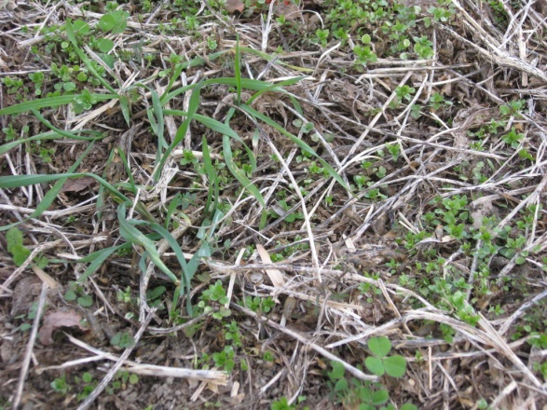
Middlesex,
Seeding Date | Previous Crop | Conditions
1-Oct | Soybean | Before leaf drop
11/30
Rye: 20-25%
Barley: 90-100%
Clover: 50-60%
Vetch: 40-50%
Rye + Vetch: 35-40%
Rye + Clover: 10-20%

Slide 5

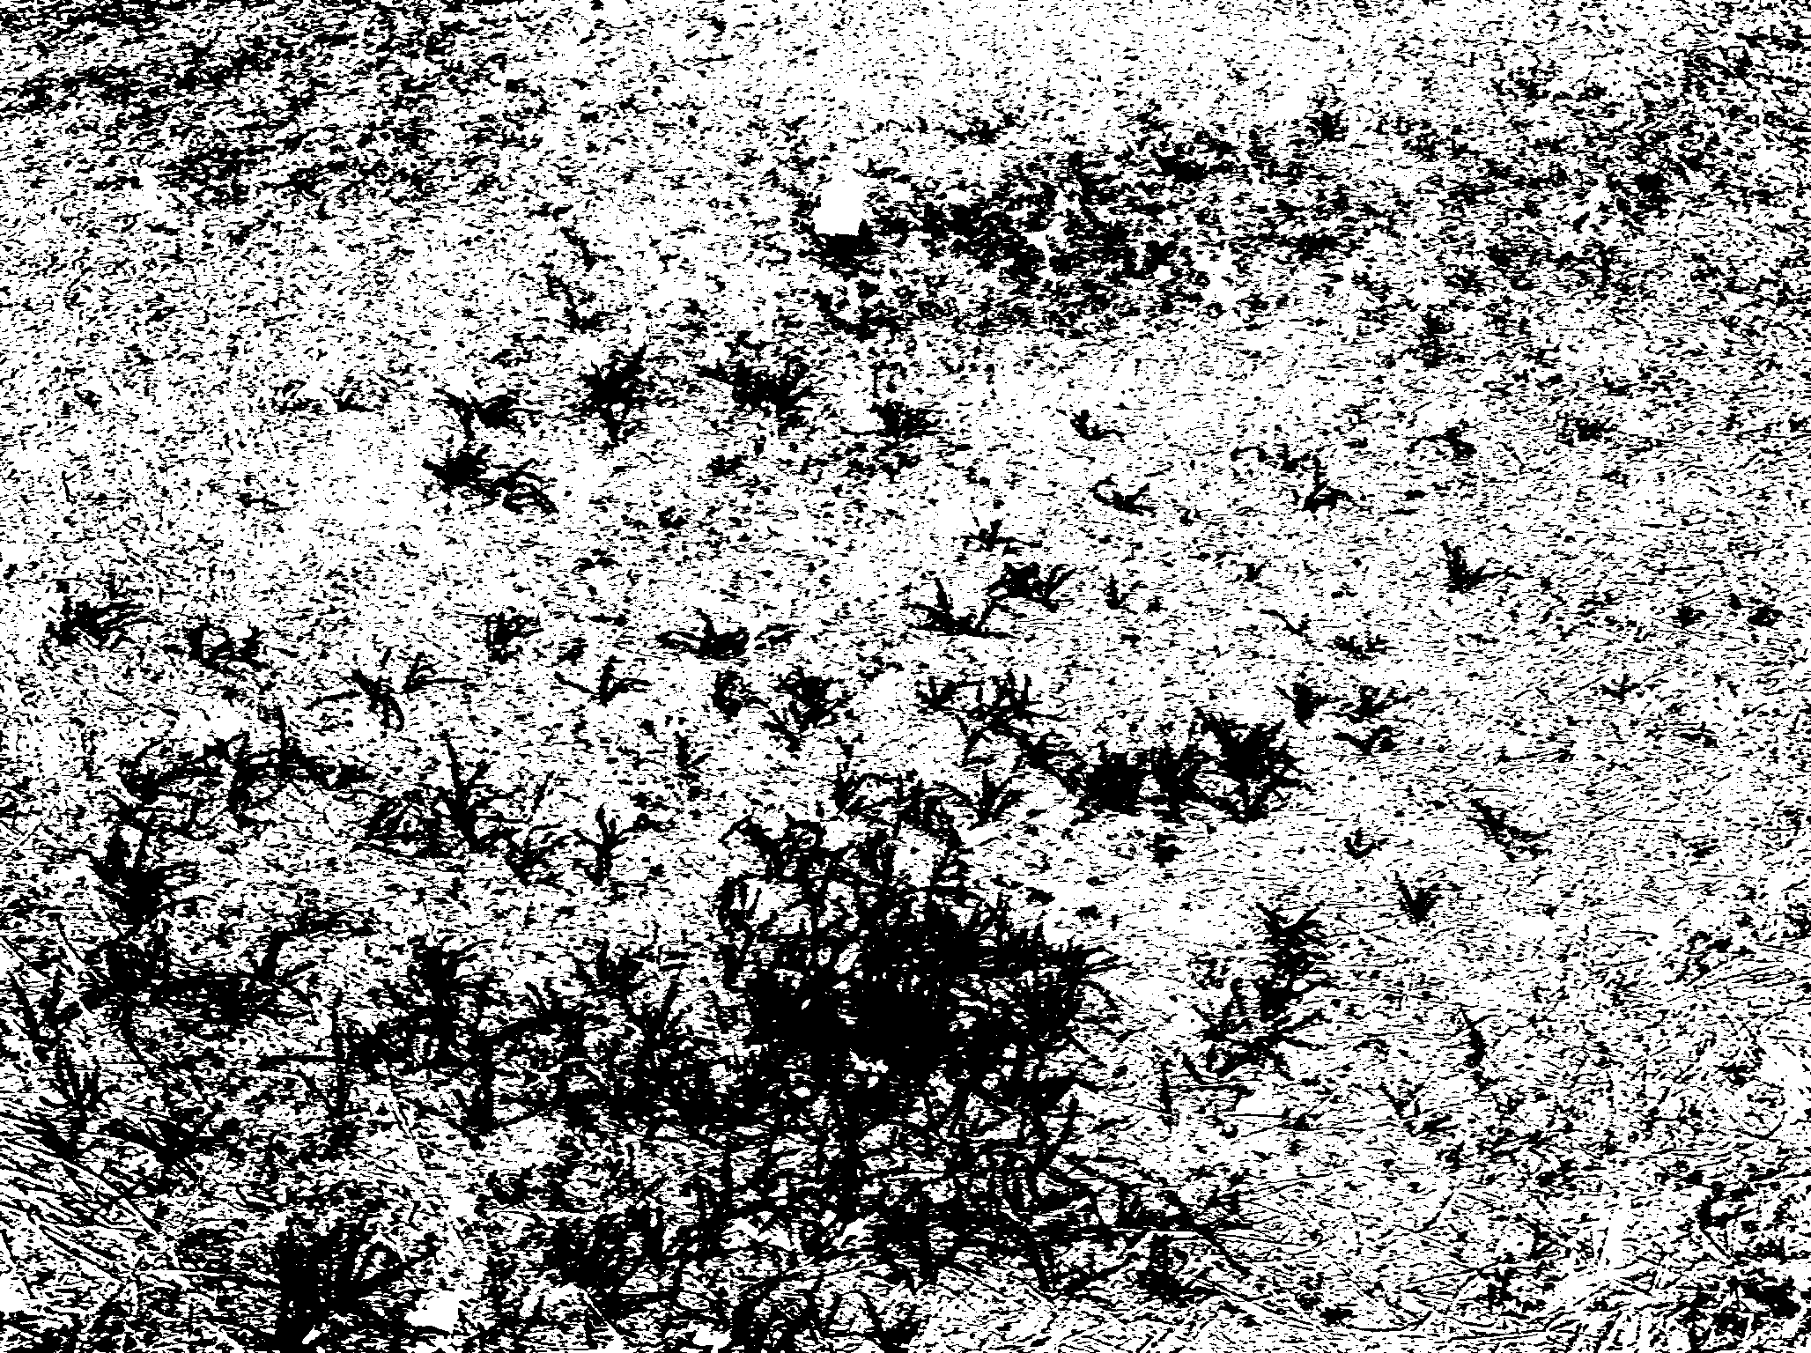

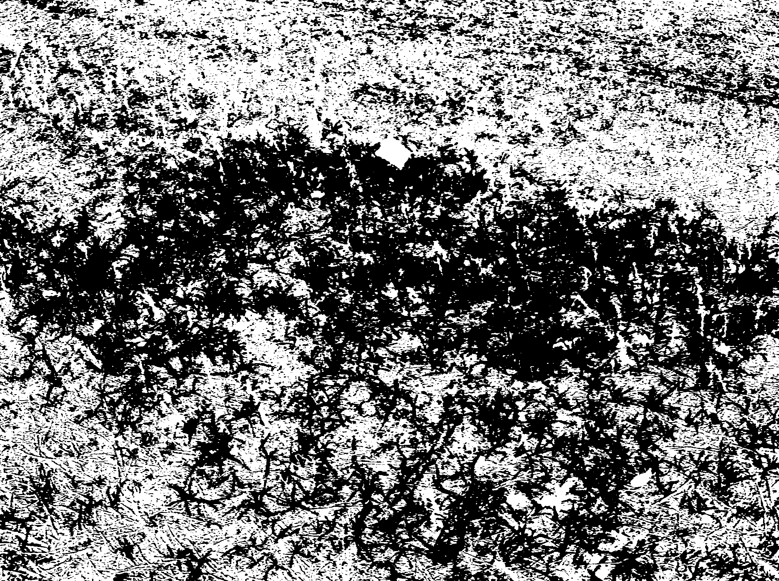
Middlesex
Seeding Date | Previous Crop | Conditions
1-Oct | Soybean | Before leaf drop
37.2%
Rye
52.7%
Barley

Slide 6
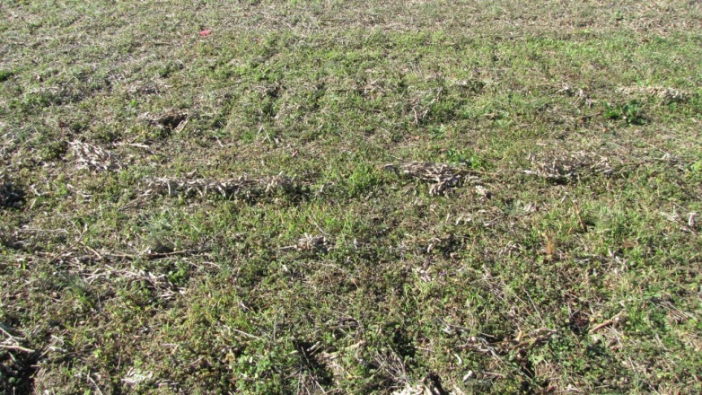
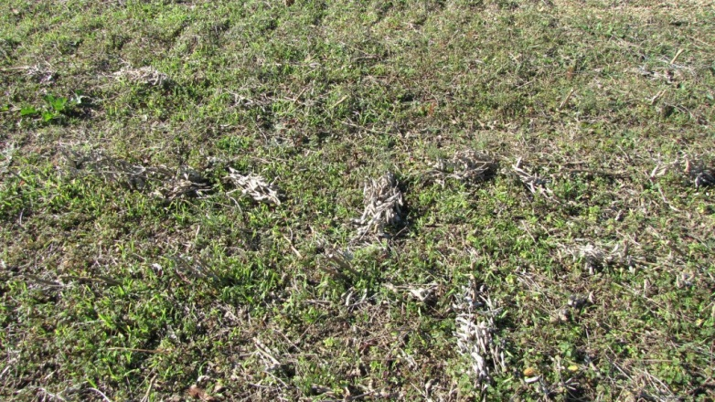
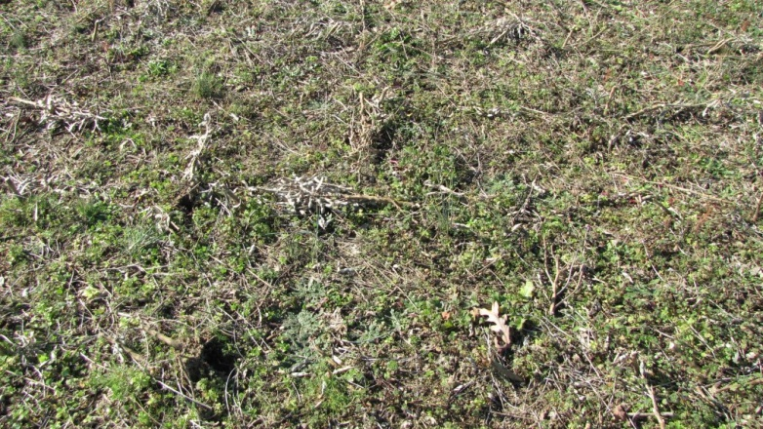
Greensville
Seeding Date | Previous Crop | Conditions
28-Oct | Soybean (18”rows) | After leaf drop
12/01
Species Plants/sq ft
Vetch: 3
Rye: 12
Barley: 8
Clover: 2
Rye/Clover: 6/1
Rye/Vetch: 10/2
Rye
Barley
Clover

Slide 7
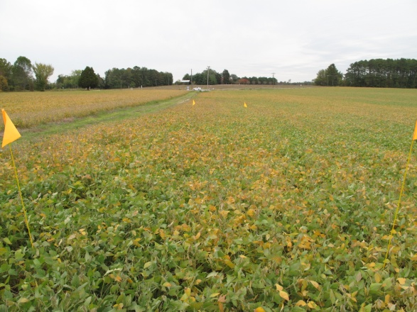
Prince George
Seeding Date | Previous Crop | Conditions
14-Oct | Soybean | 30% leaf drop
Seeded into double-crop soybeans with straw left on field from wheat harvest
Seeded October 14, 2009
Soybeans had approximately 30-40% leaf drop
Rainfall occurred on October 15
Soybeans harvested November 30
Sandy loam soil types
Pictures 12-1-09
“I would consider this seeding a failure at this site”. Scott Reiter

Slide 8
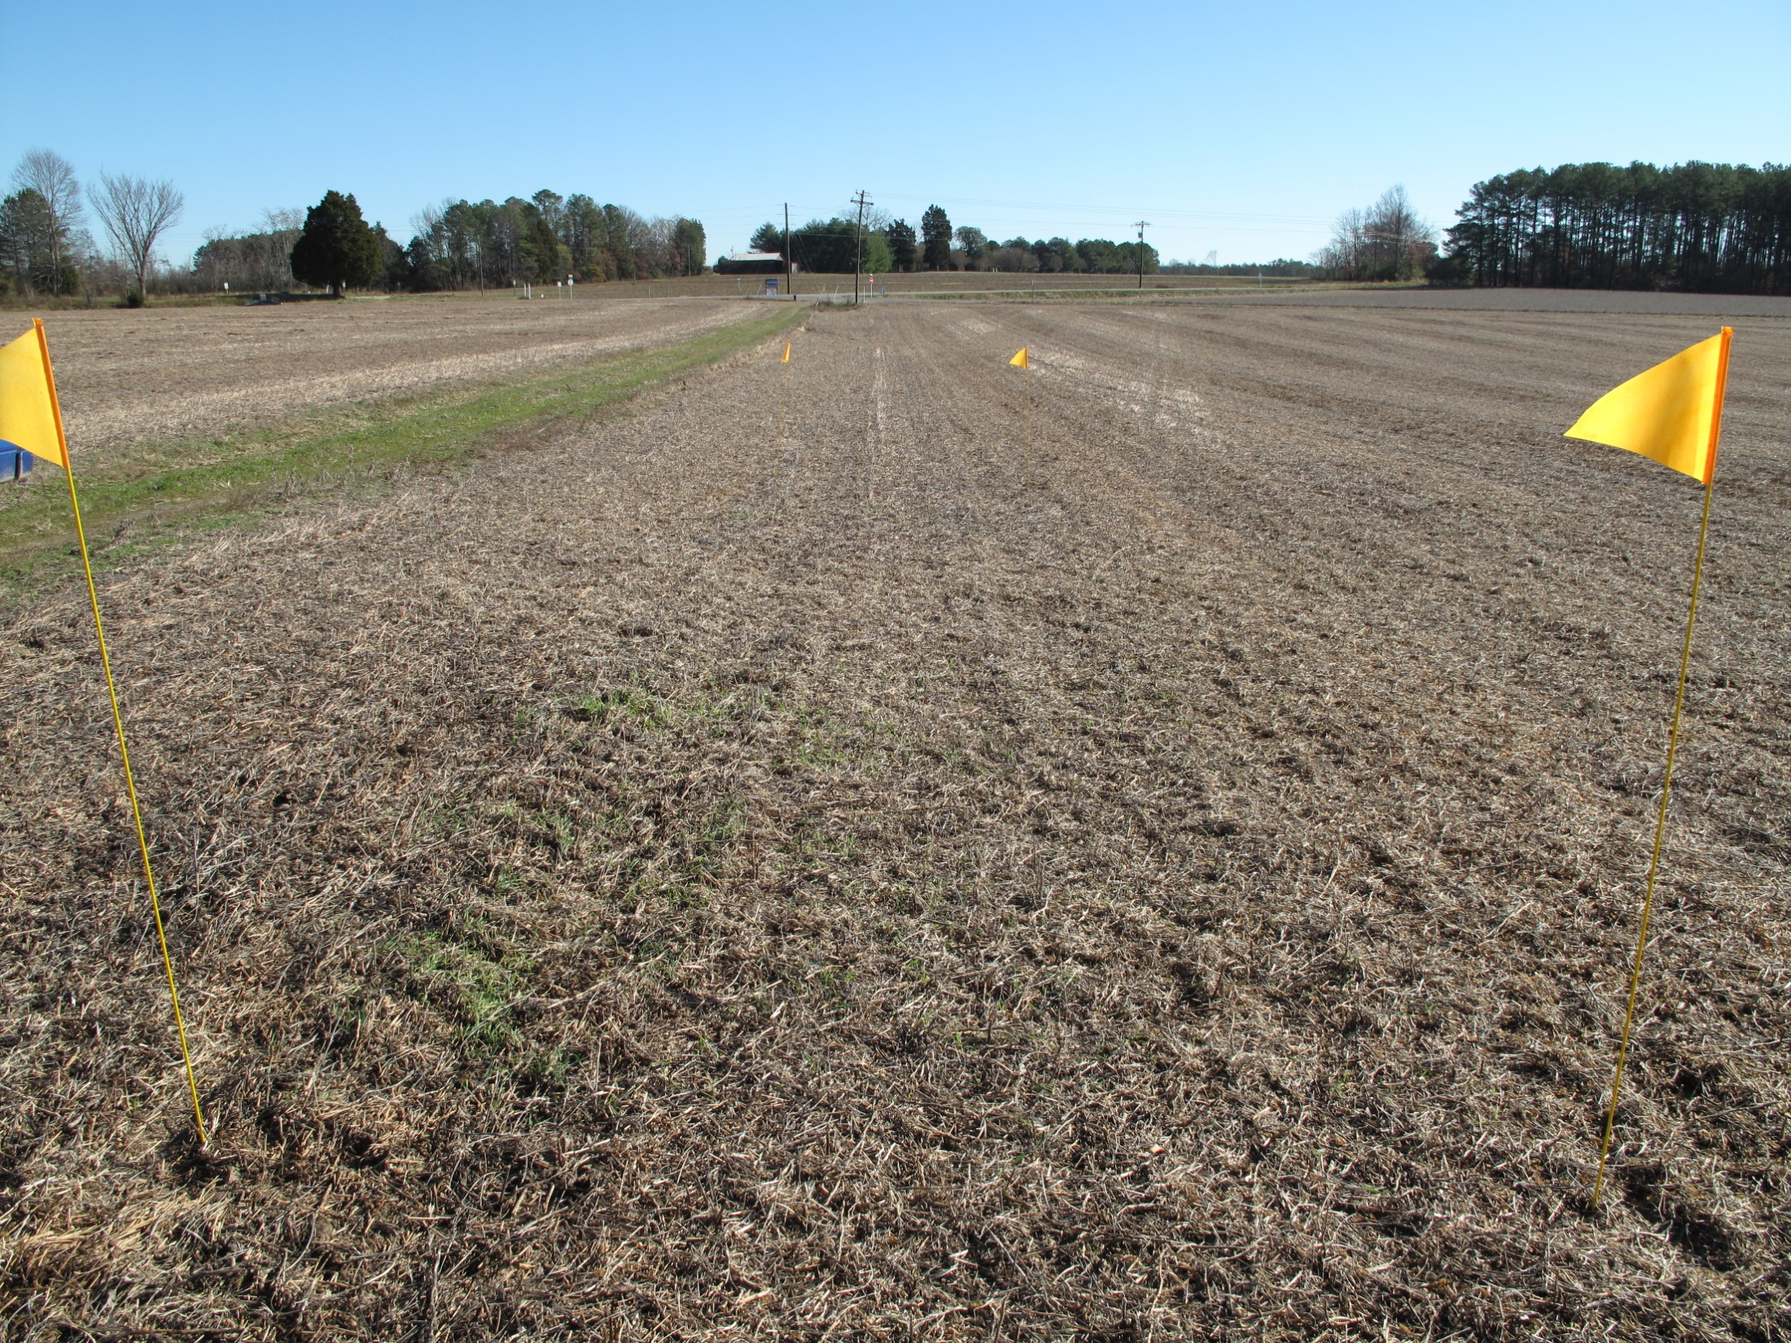
Prince George
Aerial seeding plots 12-1-09

Slide 9
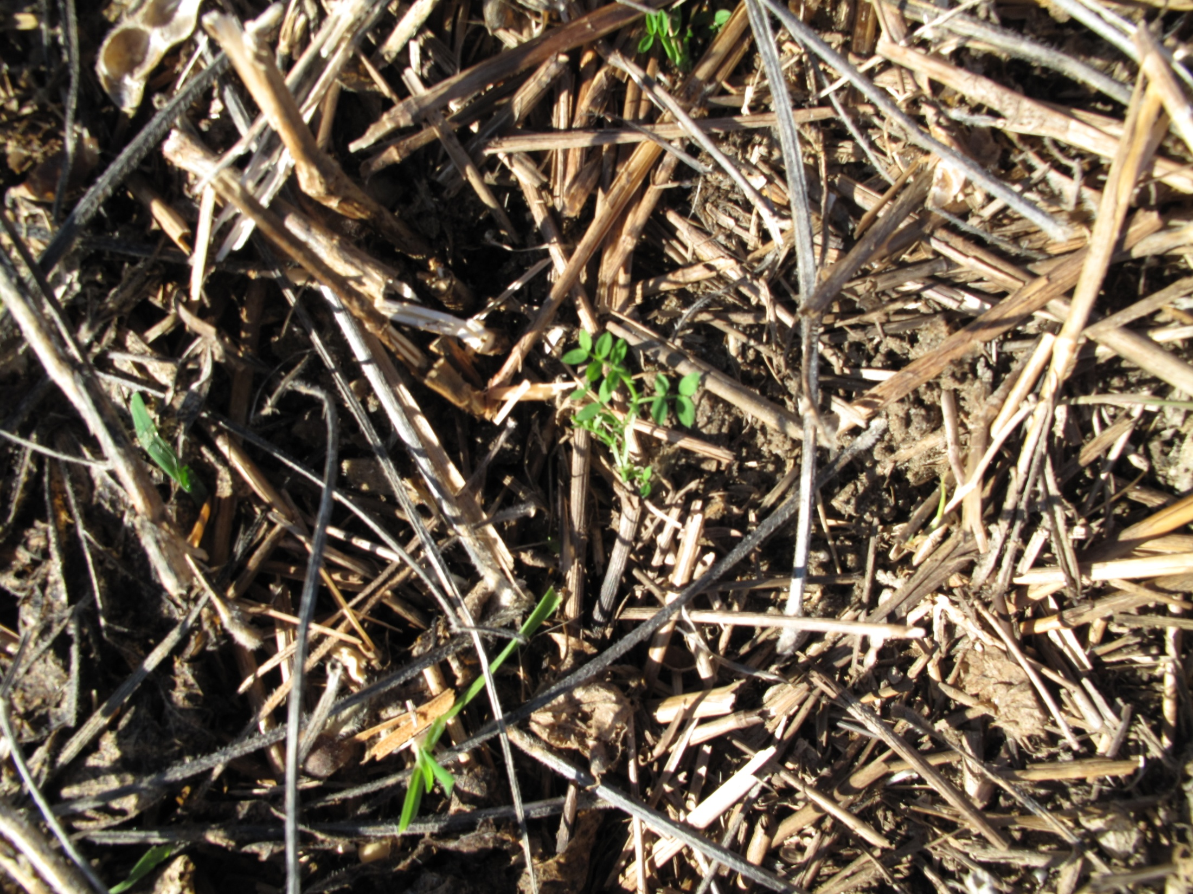
Prince George
Lone vetch seedling

Slide 10
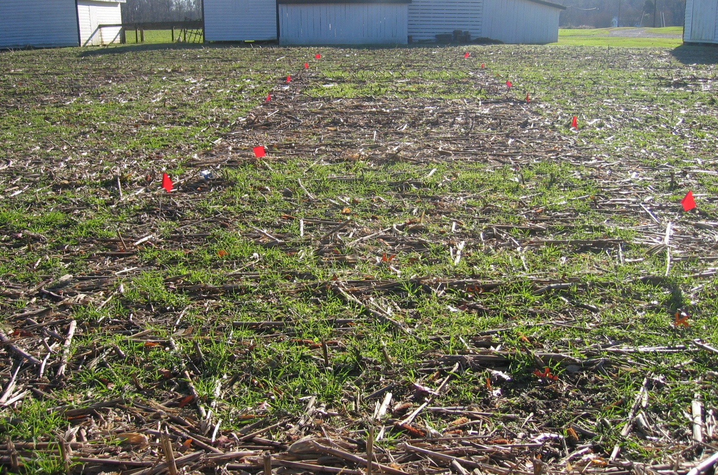
Essex
Seeding Date | Previous Crop | Conditions
2-Oct | Corn, 160 bu/ac | Stalks bush hogged
Treatments planted on October 2nd. Good soil moisture at the time of planting, but no rain for about 12 days after planting. Rye started germinating very quickly and some of it was up in 7 days or so. Barley was close behind. Took longer for the vetch and clover to germinate.
11/30
Rye
Barley
Clover
Vetch
Rye+Clover
Rye+Vetch

Slide 11
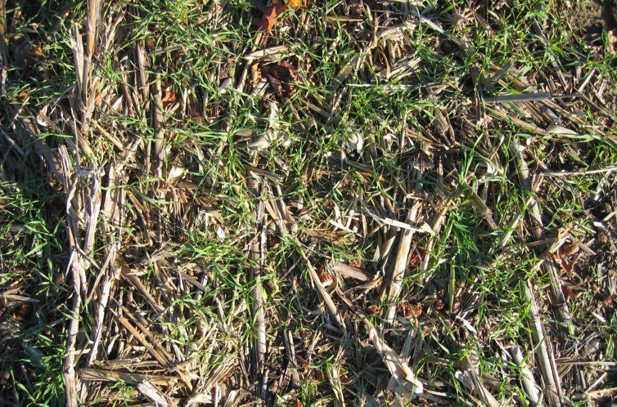

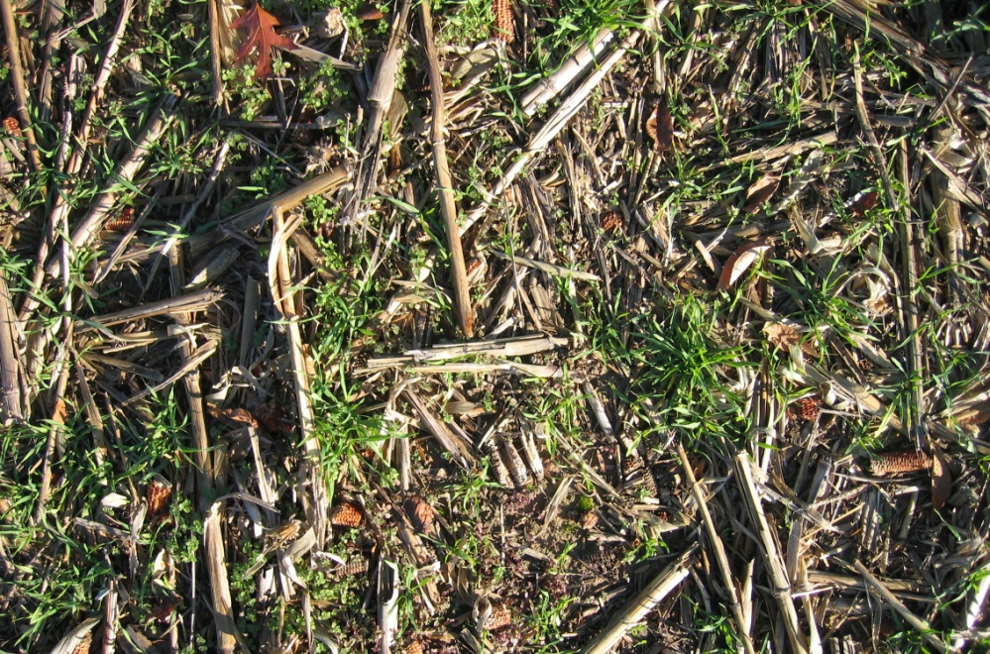

Essex
Rye 42.4%
Barley, 40.1%

Slide 12

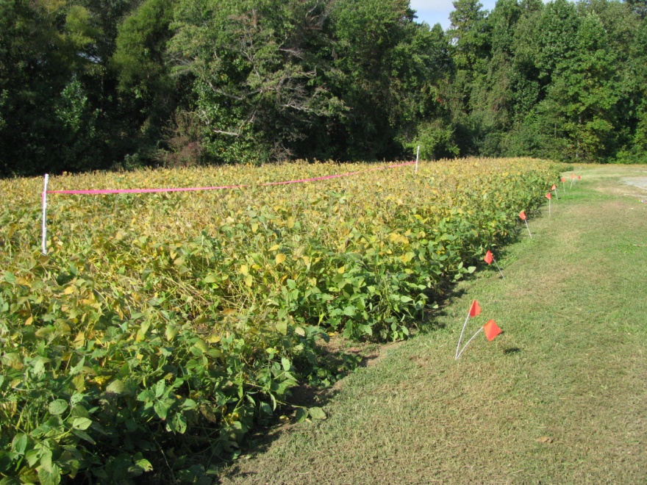
Northumberland
Seeding Date | Previous Crop | Conditions
6-Oct | Soybean | Before leaf drop
The plot was planted October 6. Weather at that time and since has been unusually warm and wet; if there was ever a fall when seed would sprout without good soil contact, it was this one.

Slide 13
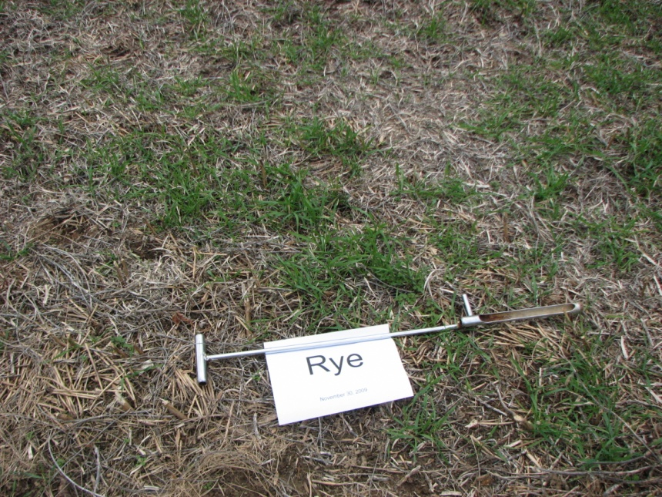
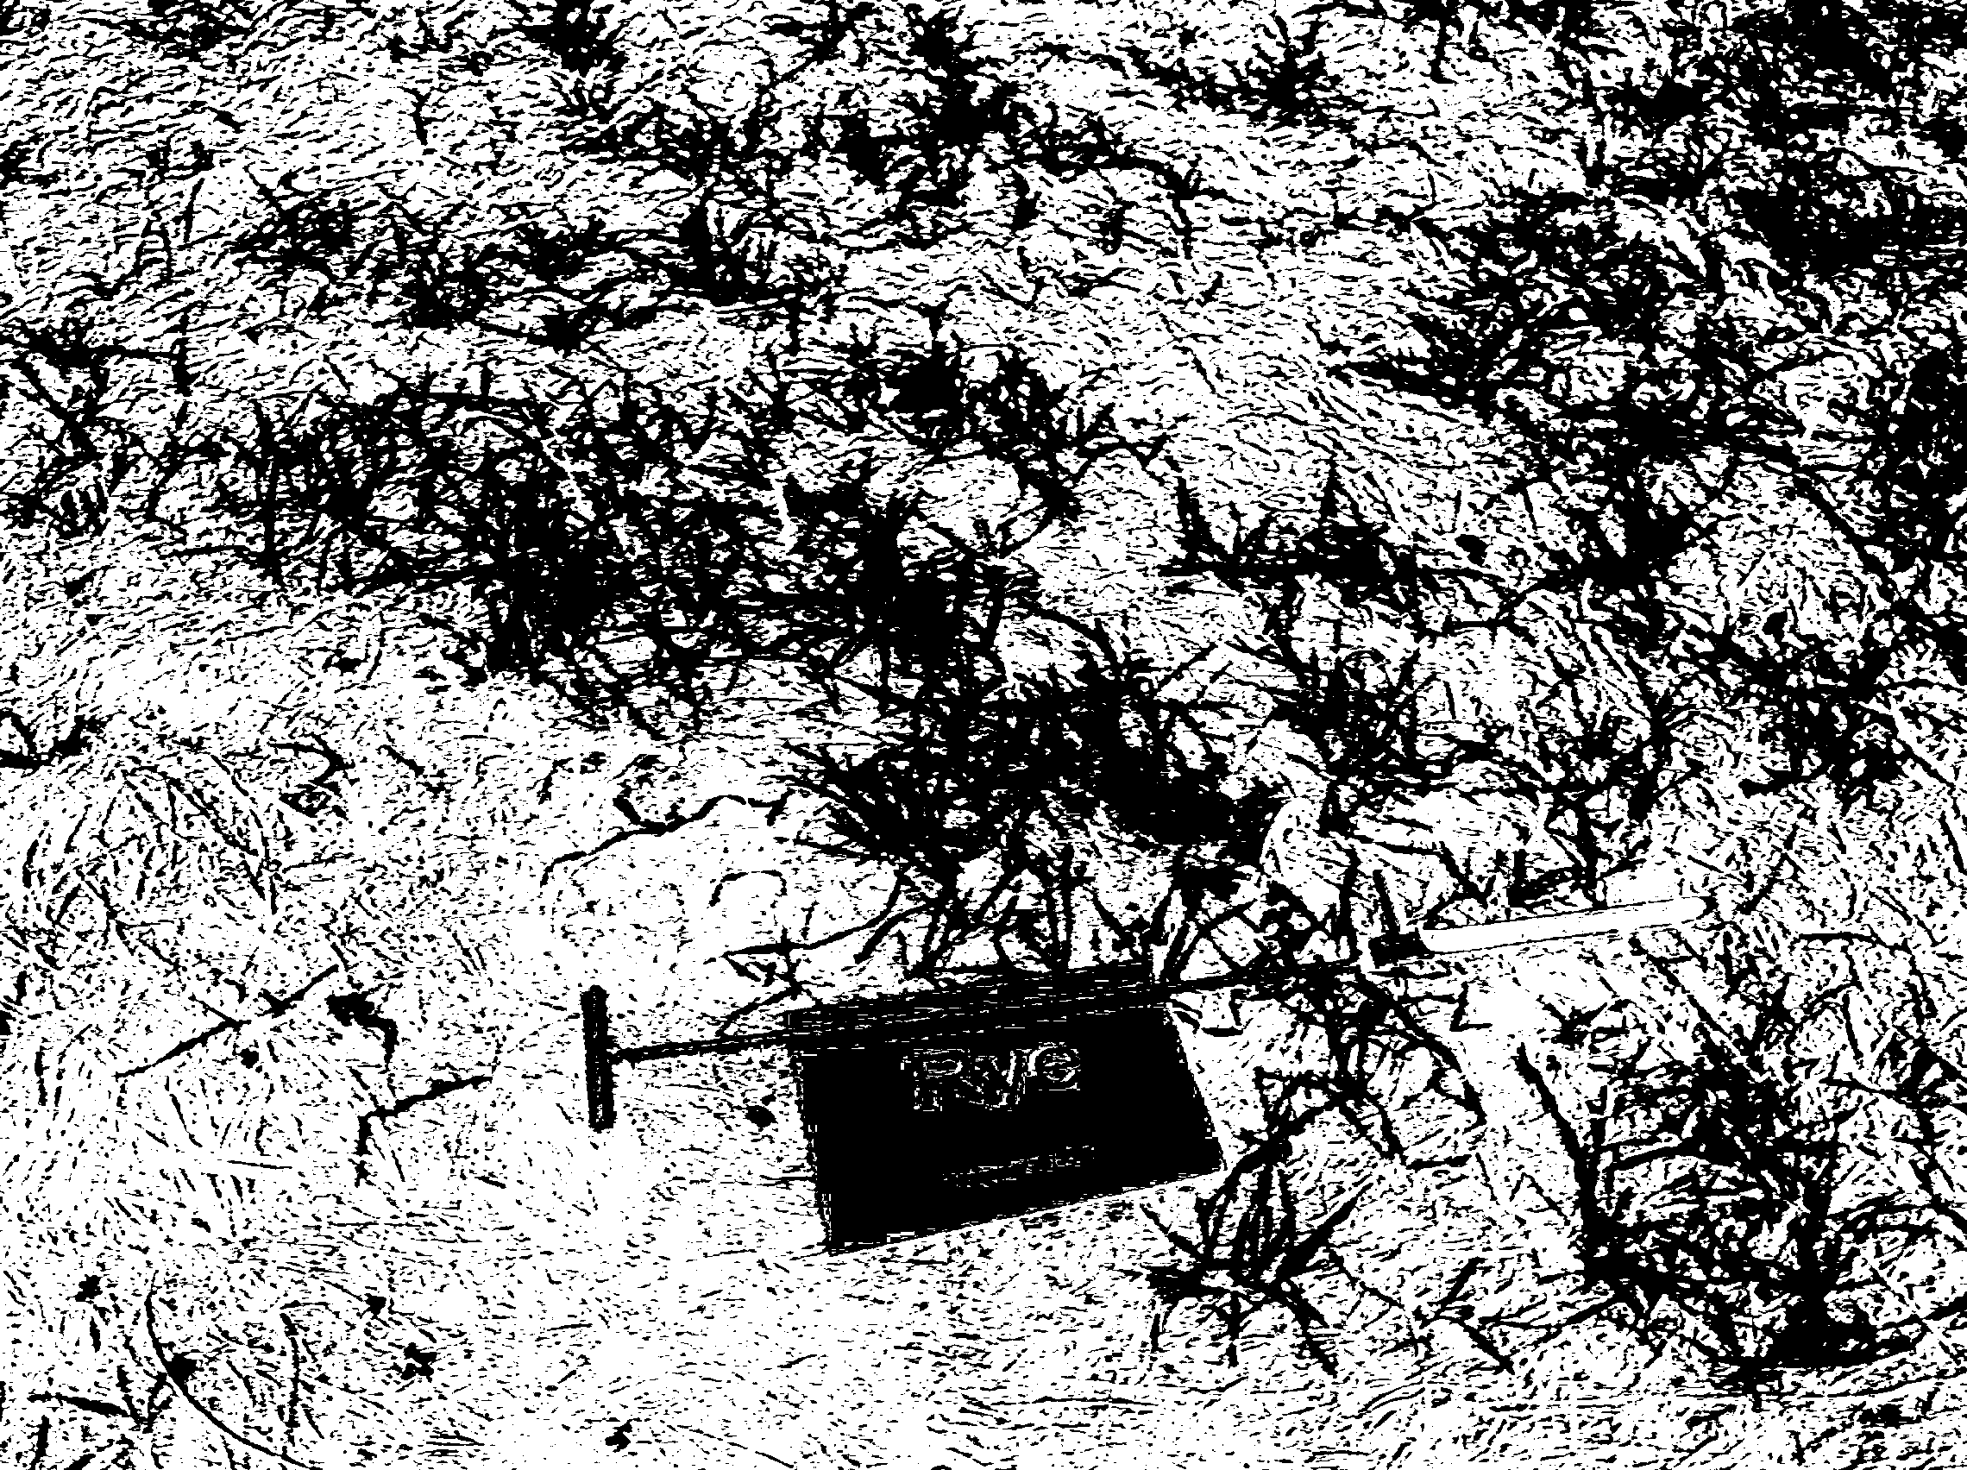
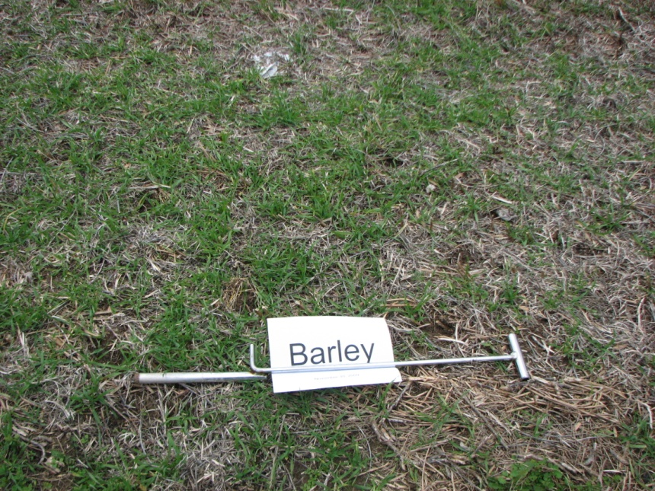
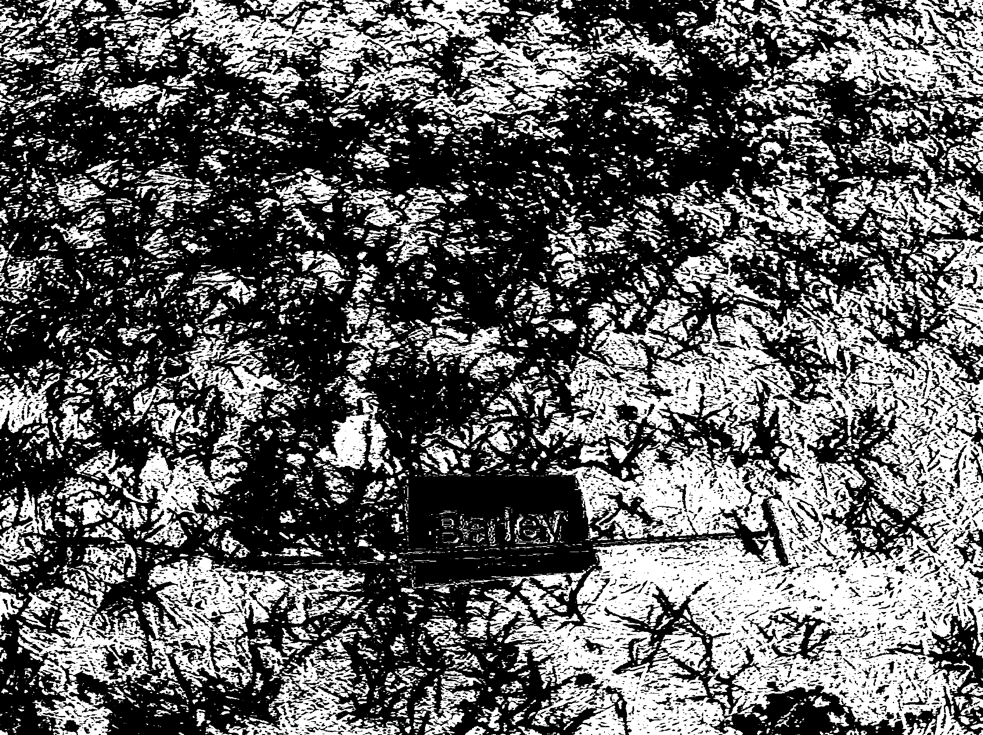
Northumberland, 11/30
Seeding Date | Previous Crop | Conditions
6-Oct | Soybean | Before leaf drop
42.4%
60.6%

Slide 14
Initial Observations
Early establishment and early-season growth are key.
  How much growth do we need?
Crimson clover needs to be seeded earlier
  Also Vetch?
Mixes need to either: 1)include more legume seed or; 2) include less small grain

Slide 15
Initial Observations
As of 11/30:
  One plot had a very poor stand, two more were marginal
  Barley provided more ground cover at 2 sites
  Everything worked well at Halifax – tillage?

